Slide 2
The Second World War
For children who were alive during the years 1939 – 1945, their childhood was dominated by the Second World War. Here are some facts about this war:
It started only 21 years after the First World War had ended.
The Allied countries were lead by the United Kingdom, France and the Soviet Union. The United States of America joined the Allies in 1941 after Japan bombed Hawaii.
The Axis countries were lead by Germany, Italy and Japan.
During the war, millions of Jewish people and other groups of people were murdered in what is known as the Holocaust.
Germany surrendered on 8th May 1945 which was known as Victory in Europe Day (VE Day).
Japan surrendered on 2nd September 1945 on VJ Day (Victory in Japan Day). This officially brought the Second World War to an end.
Have you ever met anyone who was alive during the Second World War? If so, did they tell you what it was like to live through it?
Talk About It

Slide 3
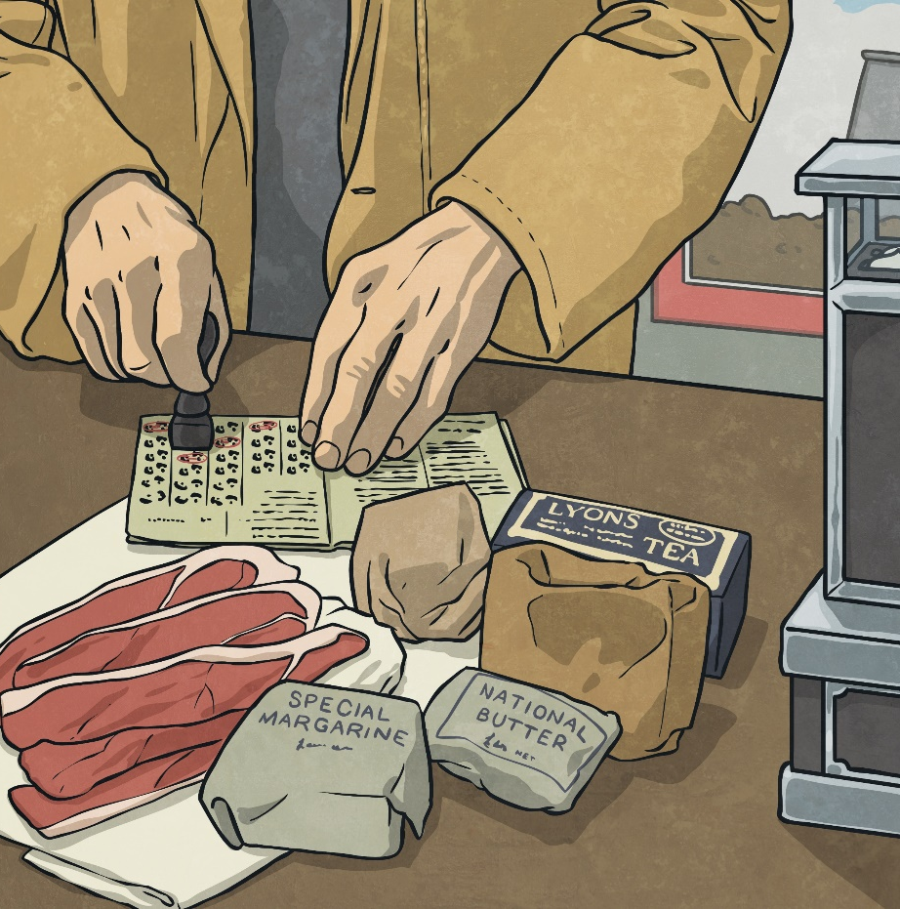
Rationing
Rationing was where things such as food, clothing and petrol were limited to a certain amount per person. This was to make sure that food was shared out fairly and that everyone had what they needed. Goods became scarce because German submarines started attacking ships that brought things to Britain. The country had to become self-sufficient and a way of doing this was to ration things. Rationing began in January 1940 and gradually most food was rationed.

Slide 4
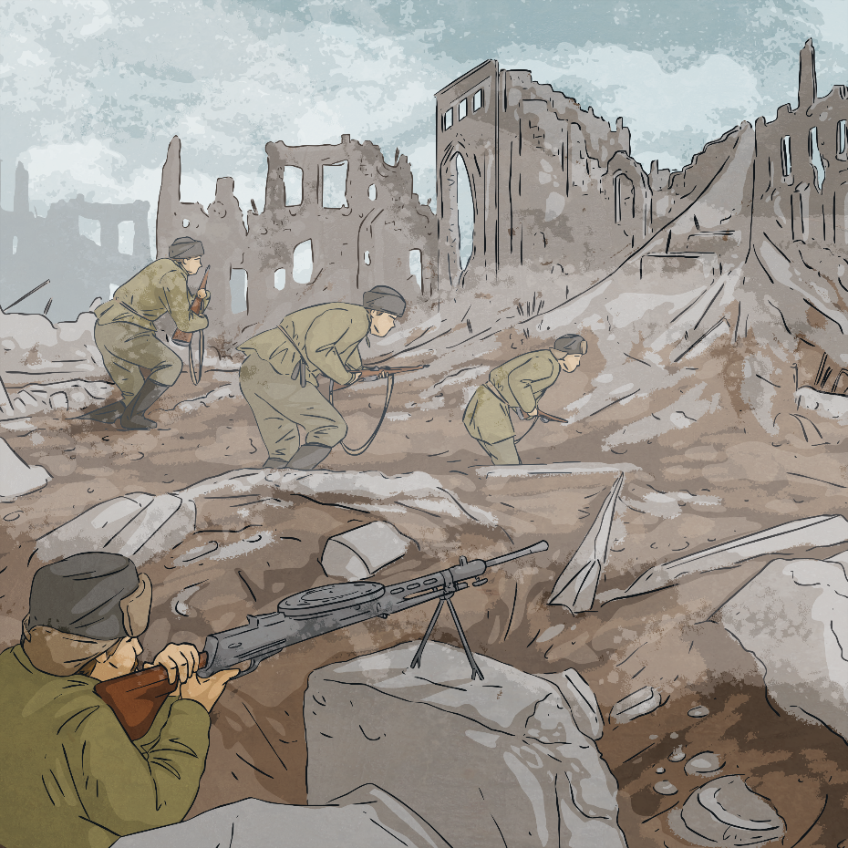
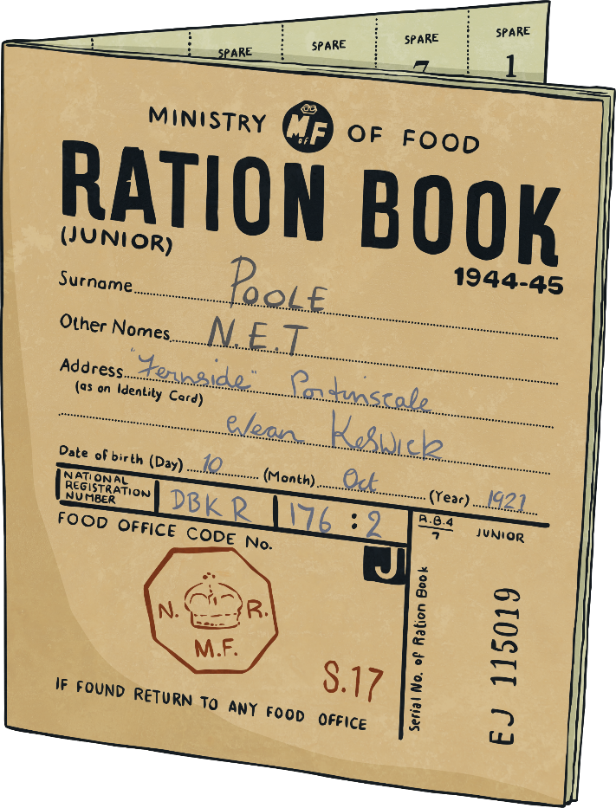
Rationing
People were given ration books which had food coupons in them. Every time they bought food, the shopkeeper took a token. This made sure people only bought the food they were allowed to have. Have a look at this Ration Book Families were encouraged to turn their gardens into allotments, in order to grow their own fruit and vegetables.

Slide 5
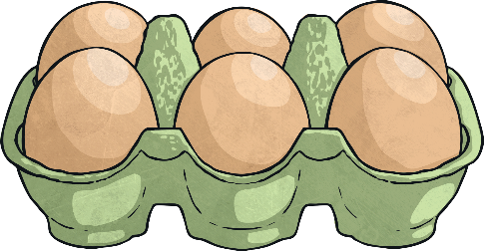
Rationing
A weekly ration for one person was usually:
50g butter, 225g sugar, 50g cheese, 100g bacon or ham, 1 egg, 100g margarine, 1.8 litre of milk, 50g of tea.
A simple thing like making a birthday cake became a maths challenge for the cook! The whole family’s ration of sugar, butter and eggs would have to be used.
People were inventive during the time of rationing. A substitute called powdered egg was used (it tastes about as nice as it sounds!). Popular recipes included:
Eggless Cake
Rabbit Stew
Vegetable and Oatmeal Casserole
Mock Fish Cakes
Eggless Mayonnaise

Slide 6
Rationing
Rationing of some food continued until 1954, nine years after the end of the war! It was an exciting time, although a bit confusing for some children. Children hadn’t seen bananas for so many years that some didn’t know how to eat them and tried to eat them with the skin on!
Think about all the food you would miss if you had lived at this time. What could you have eaten instead?
Talk About It

Slide 7
Soldiers
Family life was greatly affected by the Second World War. Britain didn’t have enough soldiers to fight a war so introduced conscription. This meant that all men aged between 18 and 41 were required to register for service, unless they were doing certain jobs, such as mining or farming. This meant that most children’s dads had to leave and fight.
Children would hear from their dads in postcards and letters. However, these were censored to ensure that if a German spy got hold of them, the spy wouldn’t know any details about what soldiers were doing.

Slide 8
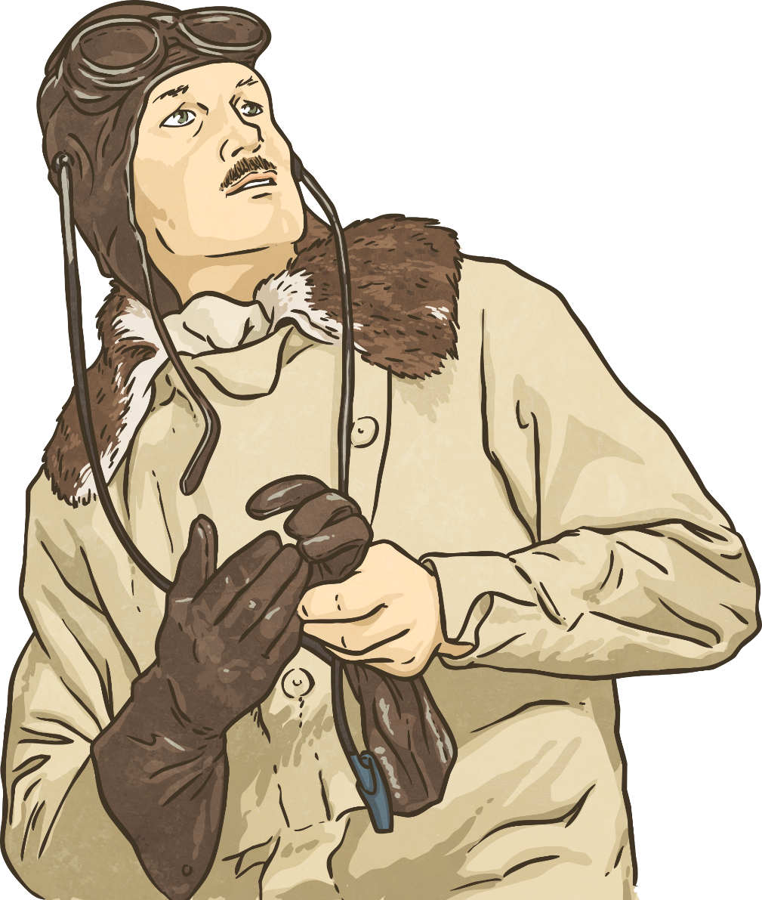
Soldiers
Soldiers were only allowed a few days leave each year. If they were fighting thousands of miles away, they couldn’t travel home. This meant that many children didn’t see their dads for the entire length of the war.
It is estimated that between 300,000 and 500,000 children lost their fathers in the war.
If you were writing a postcard to a family member who was thousands of miles away, what would you write about? You could write down your ideas on a Twinkl Postcard Template.
Talk About It

Slide 9
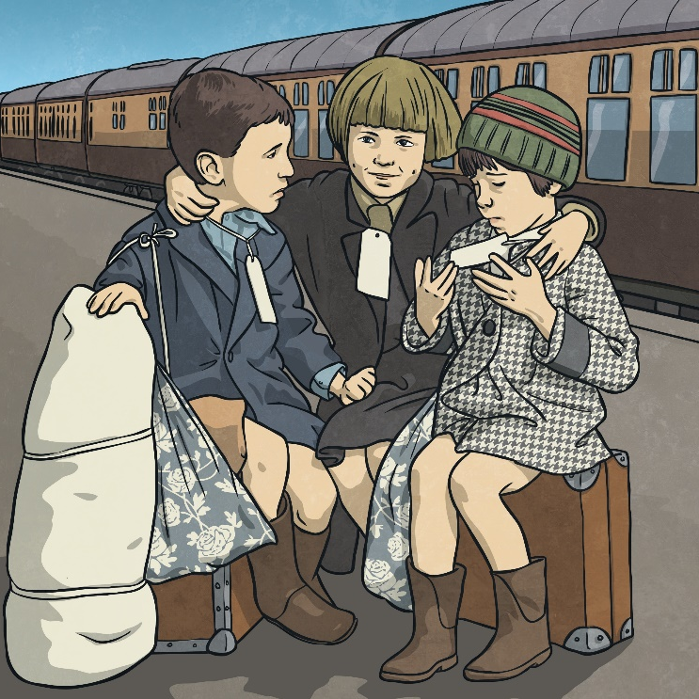
Evacuation
At the start of the war, the government realised that cities would be targeted. They decided to encourage parents to allow their children to be evacuated to safer, rural locations.
Parents were given a list of things to pack for their children. The children had labels attached to them with their name, age and home address on them.
Children were taken on trains or buses to their new locations. A person called a billeting officer would collect the children and take them to a village hall. People who had volunteered to take in the evacuees would then walk amongst them and choose the children they liked the look of.

Slide 10
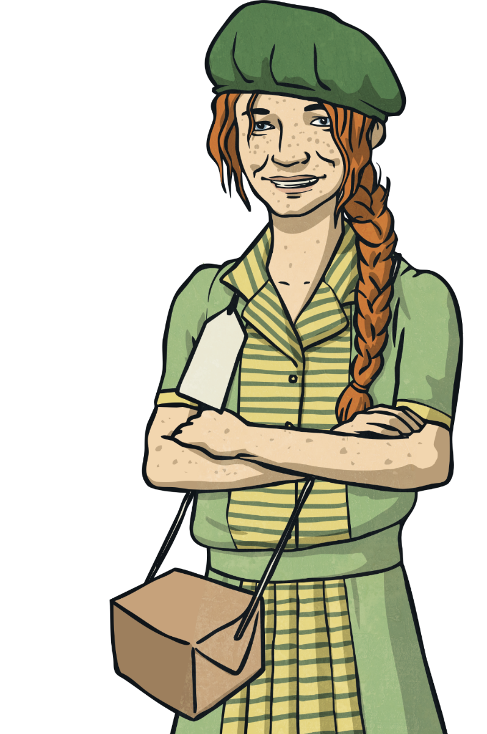
Evacuation
Over one million children were evacuated during the Second World War. Thousands of children were sent to places such as Australia and New Zealand.
Look at this Twinkl Evacuation Reading Comprehension Pratice Activity.
What impact do you think the bombing raids had on children?
Talk About It

Slide 11
Evacuation
For some children, evacuation was a positive experience. For others it was not. Talk about the positives and negatives of being evacuated.
Talk About It
Positive Points of Evacuation | Negative Points of Evacuation
Children were kept safe from bombs. | Children missed their parents.
Children got to live in the peaceful, beautiful countryside. | Sometimes brothers and sisters were kept in separate places.
Many children stayed with caring people. | Some children stayed with people who weren’t very nice to them.

Slide 12
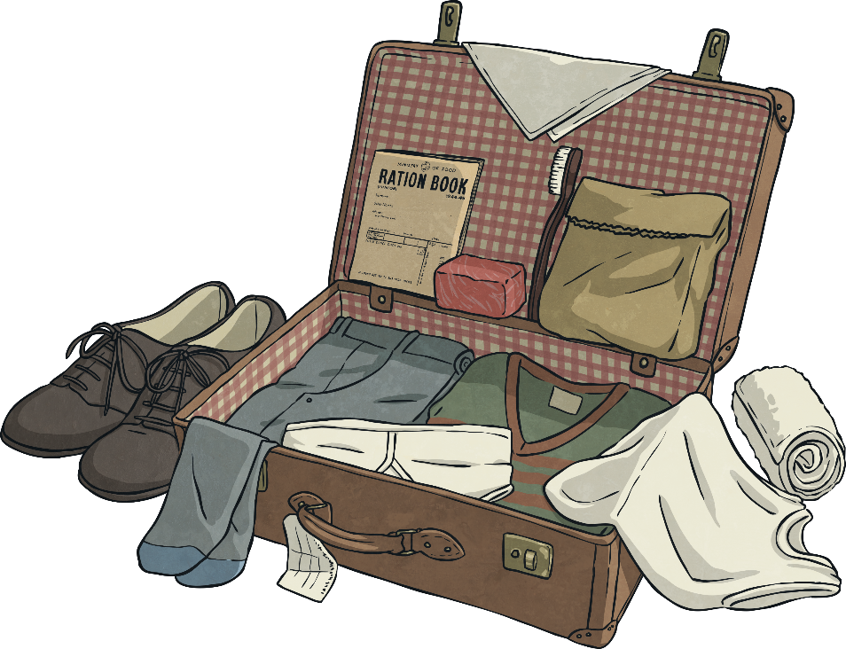
Evacuation
Parents were given a list of things to pack for their children which included a gas mask, underwear, pyjamas or a nightie, plimsolls, toothbrush, comb, a towel, soap, a flannel, handkerchiefs and a warm coat.
This list doesn’t sound like very much, but some families struggled to even get these items. A lot of children who were being evacuated came from very poor families.
Some children took a toy with them but it would have been something small. They had to be able to carry all their possessions themselves in one small suitcase.

Slide 13
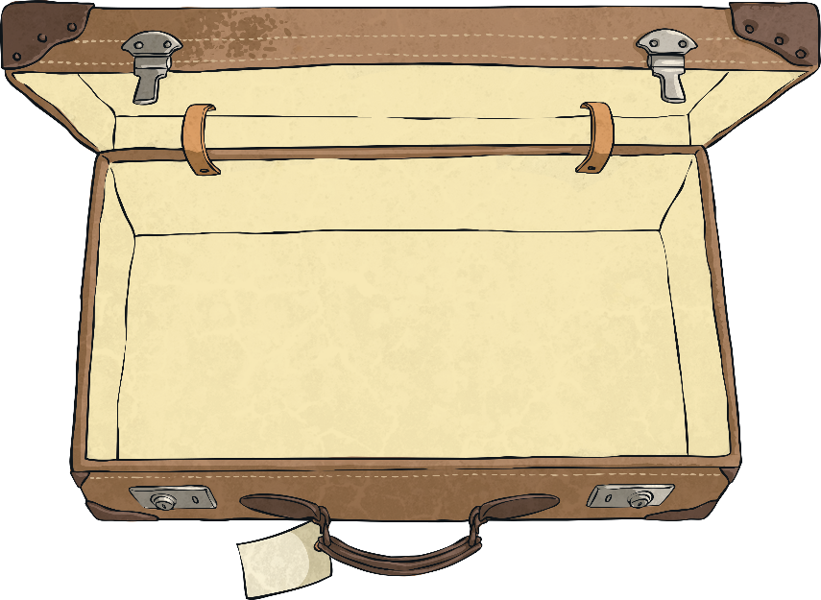
Evacuation
Your task is to imagine you are being evacuated and you have to decide what to pack.
You will need to think about the following things:
What practical items will you need?
Will you take a toy?
Will you pack any items that remind you of home?
Whatever you pack, you must be able to carry it all yourself.
You could draw your items and write about them on the Twinkl Evacuation Suitcase Activity.

Slide 14
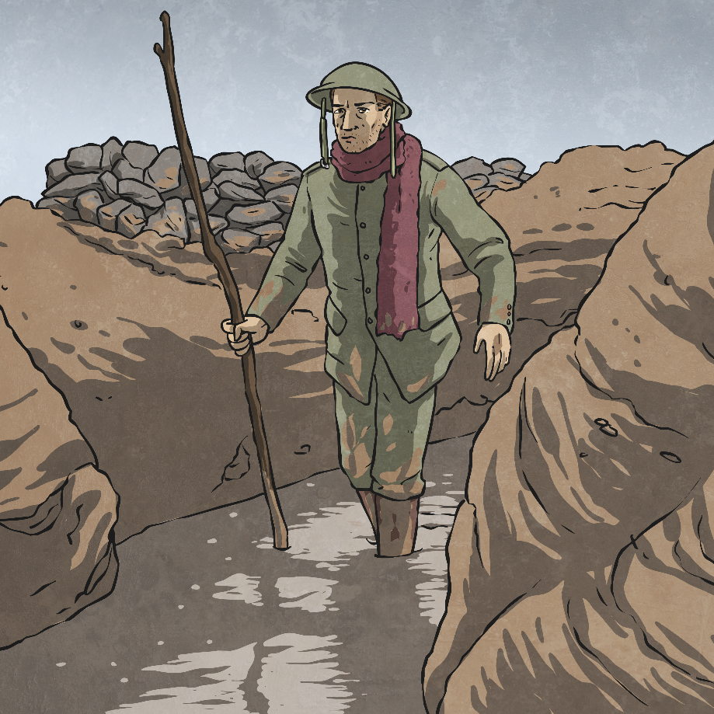
Glossary
censored – To have parts taken out.
conscription – Where it is the law that people join one of the armed forces.
evacuated – To be taken to a place of safety.
self-sufficient – To be able to produce everything needed without getting things from somewhere else.

